Slide 1
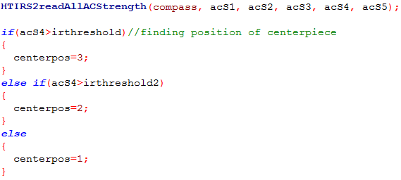
7350 Team Watt NXT, Edison New Jersey
7350 Team Watt NXT, Edison New Jersey
Title
Title: IR Sensor
Page Number
Page Number
Problem: Make a program that effectively finds what position the centerpiece is in
Solution: Use the IR Sensor to read the IR signal strengths from each center piece position
Explanation: Using 3rd party Nxt drivers from Xander, we can access the strength of the signal the IR sensor is getting. Since the signal strength will be different for each center piece position, we can use this to figure out what position the center piece is in.
This section of code gets the IR signal value and compares it with our stored values.
Recorded by Sign Date
Recorded by Sign Date
Time Start Stop
Time Start Stoph

